Slide 1
Term Project Presentation
Team 81
張瑋倫.沈韋翔.莊翔凱.林士翔

Slide 2
Outline
1. Task Overview
2. Code I: 3rd place solution(AUC=0.9767)
3. Code II: LLM_Text_Detection(99.47 % Accuracy)
4. Code III: LLM Detect AI Generated Text Use Transformer(AUC=0.9324)

Slide 3
Task Overview

Slide 4
Topic: LLM - Detect AI Generated Text
Objective:
Develop a model to differentiate between essays written by middle/high school students and those generated by large language models (LLMs).
Background:
LLMs can produce text resembling human writing, raising concerns about plagiarism and its impact on student skill development.
Educators fear LLMs may hinder learning but recognize their potential as tools to improve writing skills.
Challenge:
Detect LLM-generated text across varied subjects and multiple unknown generative models.
Promote detection methods that generalize well in real-world scenarios.

Slide 5
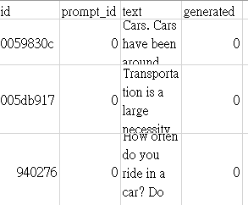
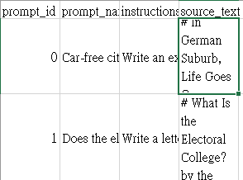
Train Dataset
train_essay.csv:
“id”: A unique identifier for each essay.
“prompt_id”: Identifies the prompt the essay was written in response to.
“text”: The essay text itself.
“generated”: Whether the essay was written by a student (0) or generated by an LLM (1).
train_prompts.csv:
“prompt_id”: A unique identifier for each prompt.
“prompt_name”: The title of the prompt.
“instructions”: The instructions given to students.
“source_text”: The text of the article(s) the essays were written in response to, in Markdown format.

Slide 6


Test Dataset & Submission Format
test_essay.csv:
“id”: A unique identifier for each essay.
“prompt_id”: Identifies the prompt the essay was written in response to.
“text”: The essay text itself.
sample_submission.csv:
“id”: A unique identifier for each essay.
“generated”: Predict result.
Please note that this is a Code Competition. The data in test_essays.csv is only dummy data to help you author your solutions. When your submission is scored, this example test data will be replaced with the full test set.

Slide 7
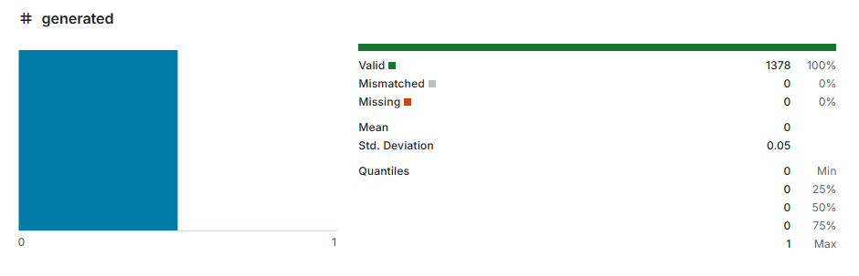
Problem of Train Dataset
Essays from two of the prompts compose the training set, the remaining essays compose the hidden test set.
Nearly all of the training set essays were written by students, with only a few generated essays given as examples.

Slide 8
Code I:3rd place solution

Slide 9
Code I:3rd place solution
https://www.kaggle.com/code/vinusebastianthomas/3rd-place-solution
Training Data set
Use train_v2_drcat_02 rather than original data.
It is because original data with only a few generated essays given as examples.
Ensemble Learning
12 deberta v3-large pretrained models
4 models training by TF-IDF prediction
Pseudo labelling
Make predictions for some of the data in the test data and add these with the training set and train again.

Slide 10
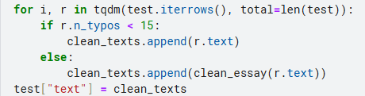
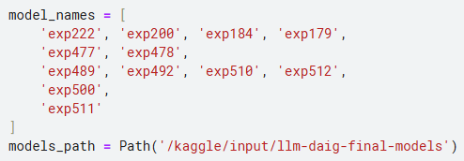
Code I:3rd place solution-data preprocessing
In this step we correct the text having spelling errors. For this a T5 deobfuscator is used as created in this post. We are correcting only the texts which have more than 15 misspelled words.
Use 12 deberta v3-large models to predict the result of test_essays.csv.

Slide 11
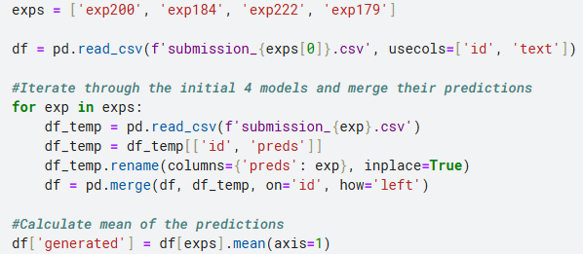
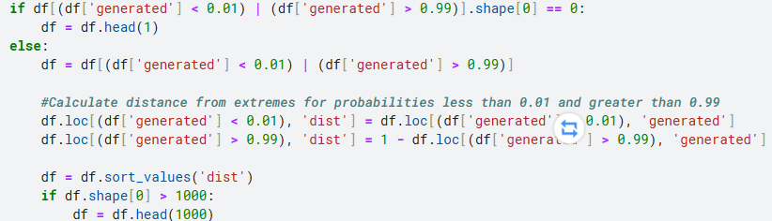
Code I:3rd place solution-pseudo labeling
Use only the first 4 models to do the pseudo labeling.
Only the 1,000 most certain answers will be considered as new objects.

Slide 12
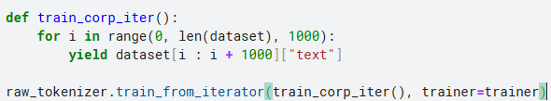
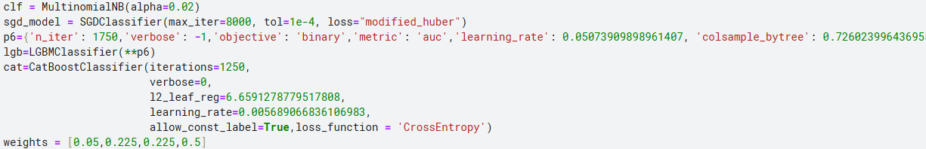
Code I:3rd place solution-TFIDF prediction
Firstly we train a BPE tokenizer on the test data and then tokenize our training data.
Use MultinomialNB , SGDClassifier , LGBMClassifier and CatBoostClassifier to do ensemble learning.

Slide 13
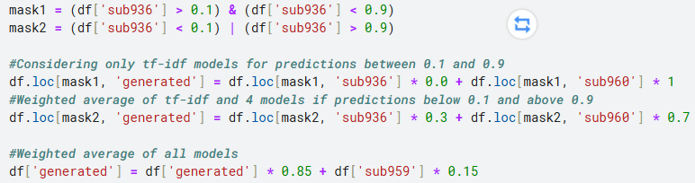
Code I:3rd place solution-final ensemble
936:Prediction results of the first four models
959:Prediction results of the last eight models
960:Prediction results by TF-IDF training
It can be seen that the first four models only work when the degree of certainty is very high.

Slide 14
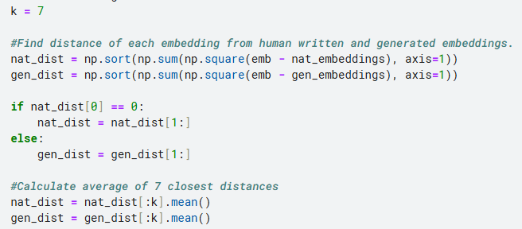
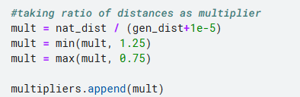
Code I:3rd place solution-post precessing
For each prompt_id, if the number of samples there greater than 1000, we fitted umap on tfidfs, calculated distance to 7 closest human-written and 7 generated samples.
And scaled predictions by the ratio human_distance / generated_distance with clipping to (0.9, 1.1).

Slide 15
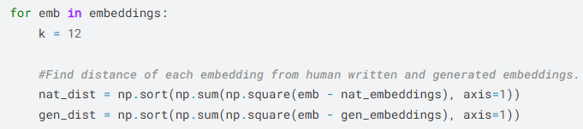
Code I:3rd place solution-experiment(1)
In post-processing, I tried to expand the original 7 recent samples to 12 to take into account and see what the results were.
But the results don’t look much different

Slide 16

Code I:3rd place solution-experiment(2)
In the part of using TF-IDF for prediction, I tried to use ComplementNB instead of MultinomialNB. The reason is that ComplementNB can calculate the complement model of each category and reduce the impact of category imbalance.
The results are still not very different, which means that the augmented data used is even enough.

Slide 17
Code I:3rd place solution-core spirit
The core spirit of this approach lies in ensemble learning and the use of pseudo labeling, which can be applied in subsequent implementations. There are currently several new methods building on this model:
1.Model rebuilding: retrain other models, or use other large language models as sub-models of ensemble learning.
2. Adding new features: there may be other more critical features that can be retrieved independently before determining whether an article is generated. Paired with pseudo labeling, better results can be achieved.
3. Strengthening the training data set: Even though it seems that the performance of the extended data set he used is already very good, there may be areas that can be further enhanced. Merging other data sets is a potential approach.

Slide 18
Code II: LLM_Text_Detection(99.47 % Accuracy)

Slide 19
Code II: LLM_Text_Detection(99.47 % Accuracy)
https://www.kaggle.com/code/harshithvarma007/llm-text-detection-99-47-accuracy/
Training Data set
Use train_v2_drcat_02 + original data.
It is because original data with only a few generated essays given as examples.
Dataset split
Split into 80-20 to validate model

Slide 20
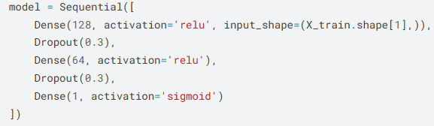
Code II: LLM_Text_Detection(99.47 % Accuracy)
Data Process
TF-IDF vectorization of Text
Encode target labels (0 and 1) using LabelEncoder
Model
simple NN:
Loss
binary_crossentropy

Slide 21
Code II: LLM_Text_Detection(99.47 % Accuracy)
post processing
Convert probabilities to binary predictions (> 0.5 → 1, <= 0.5 → 0)

Slide 22
Code III: LLM Detect AI Generated Text Use Transformer 99.3%

Slide 23
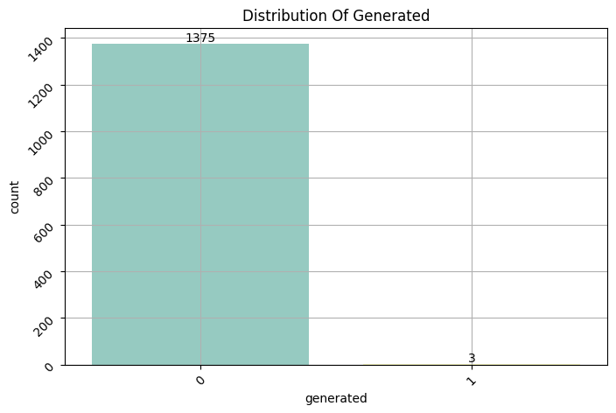
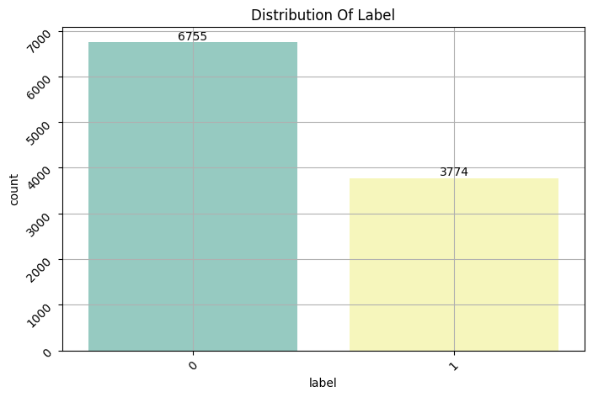
Code III: LLM Detect AI Generated Text Use Transformer 99.3%
https://www.kaggle.com/code/ahmedashrafahmed/llm-detect-ai-generated-text-use-transformer-99-3
Problem: Class imbalance in training data (generated=0/1)
Utilize an additional dataset: kaggle/input/daigt-v2-train-dataset/train_v2_drcat_02.csv to enhance the balance of the training data
Original training data
Enhanced training data

Slide 24
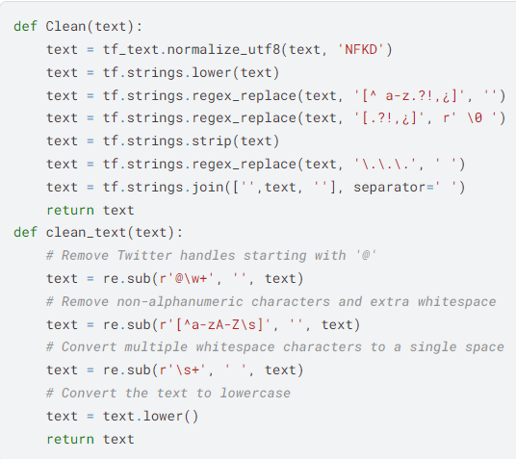
Code III: LLM Detect AI Generated Text Use Transformer 99.3%
Text Cleaning function
Clean function: Focuses on text normalization using regular expressions
clean_text function: removing unnecessary symbols (e.g. @), non-alphabetic and non-whitespace characters, then converts text to lowercase

Slide 25
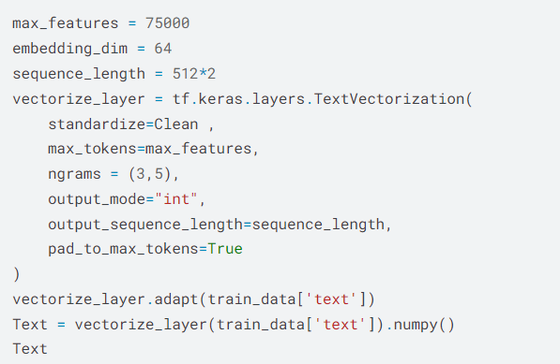

Code III: LLM Detect AI Generated Text Use Transformer 99.3%
Text Vectorization
Tokenization and vocab mapping
Fixed sequence lengths
N-grams (3 and 5-grams) for capturing text
SMOTE
A technique to handle class imbalance by creating synthetic samples for the minority class

Slide 26
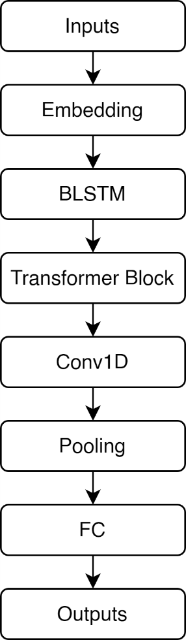
Code III: LLM Detect AI Generated Text Use Transformer 99.3%
Data split: training(80%), testing(20%) stratified
Model Highlights
Transformer block: Models sequence relationships with attention
BLSTM: Captures bidirectional context
Conv1D: Extracts key local features
Final predictions with sigmoid activation for binary classification (human/AI generated texts)

